Slide 1
Robust team

Slide 2
About our team
Our team is working together for 3 years and we are good friends we have been learned everything by ownselfs about robotics and phisics

Slide 3
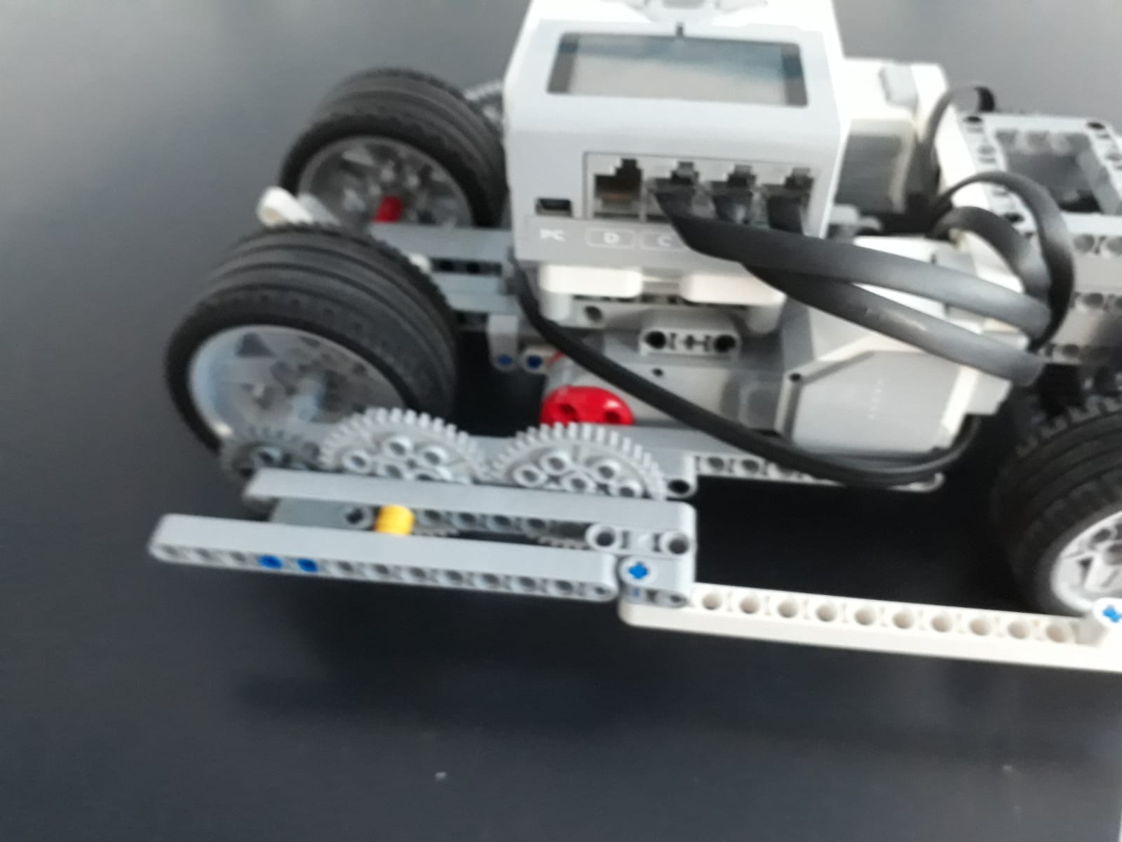
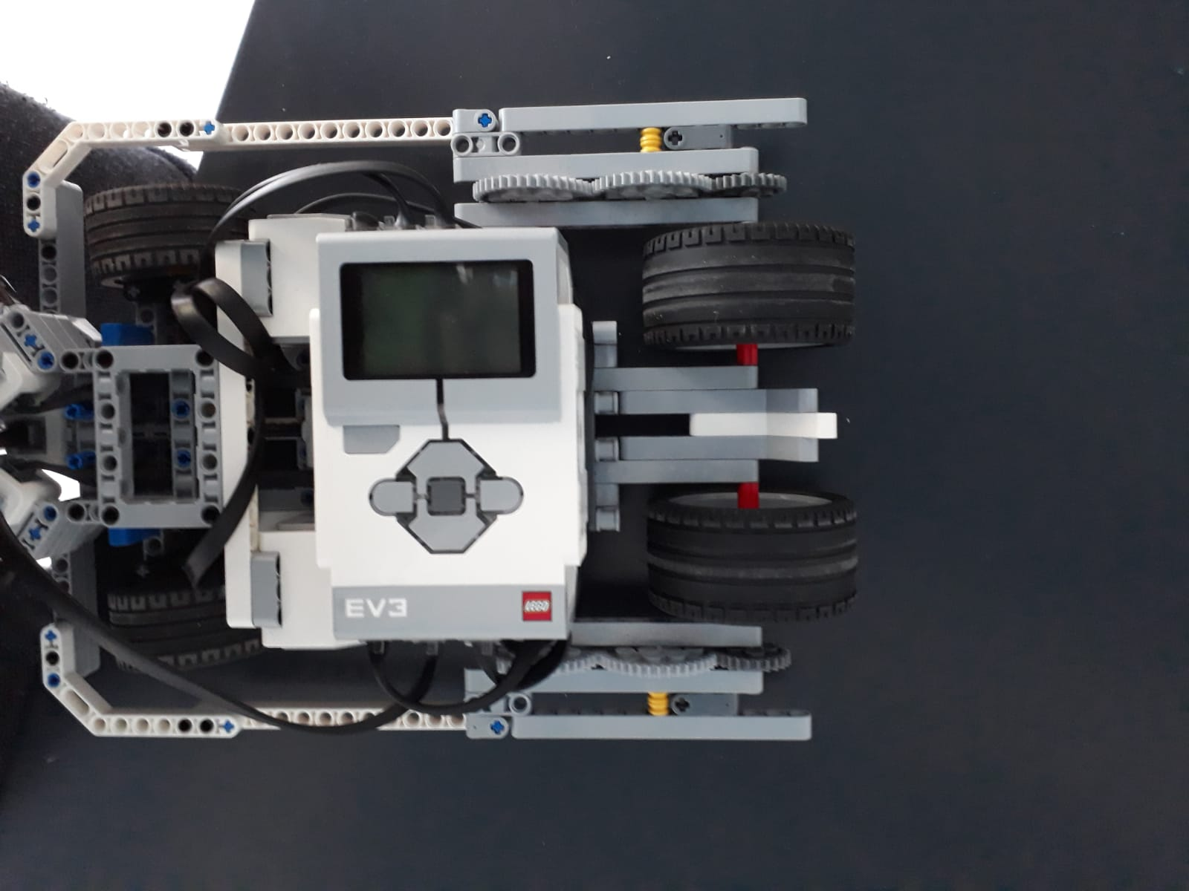
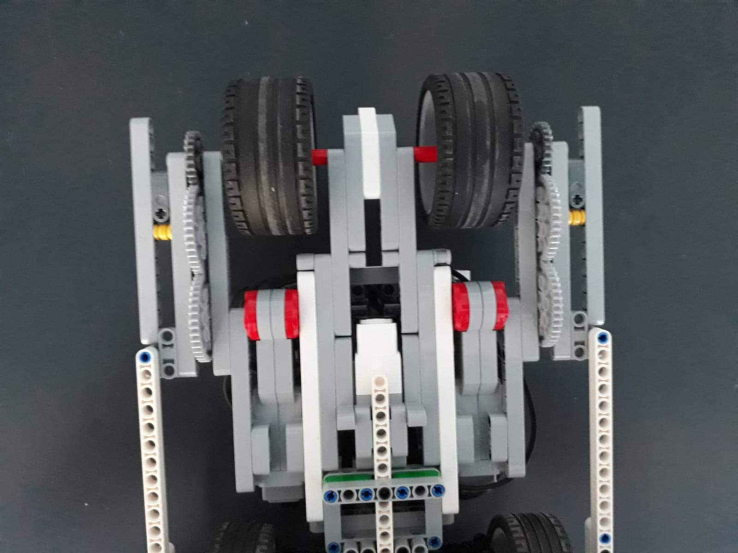
movment
Our robot have back wheel drive system and there’s two large motors for more thrust and more torque and the thrust motors working together like a 1 motor becouse they fixed together in a same shaft .

Slide 4
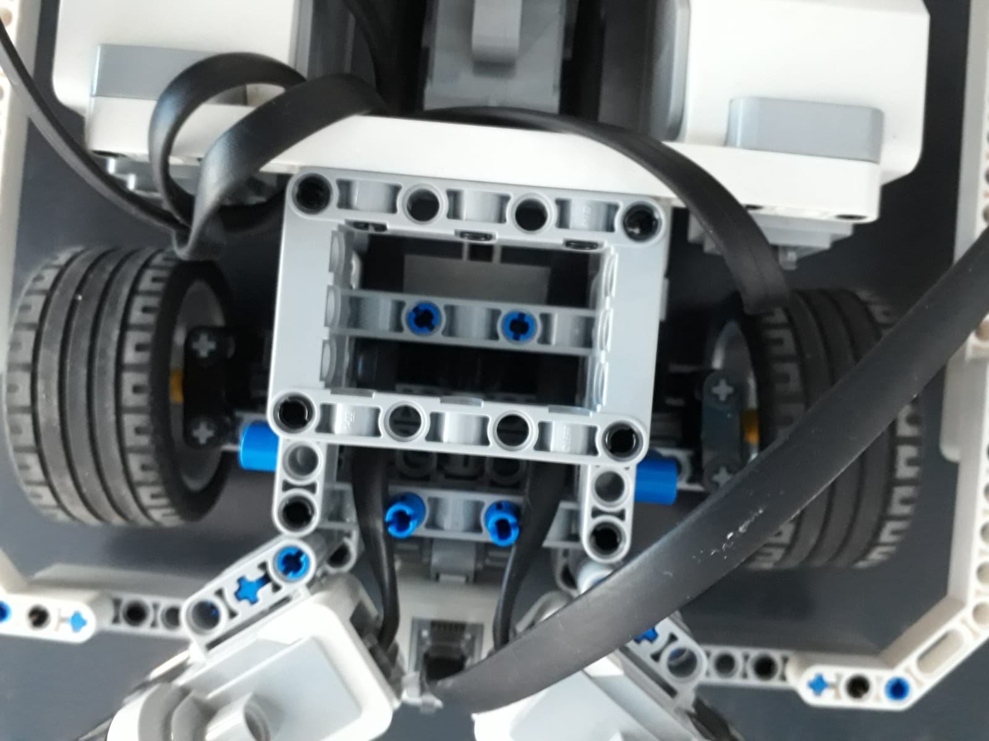
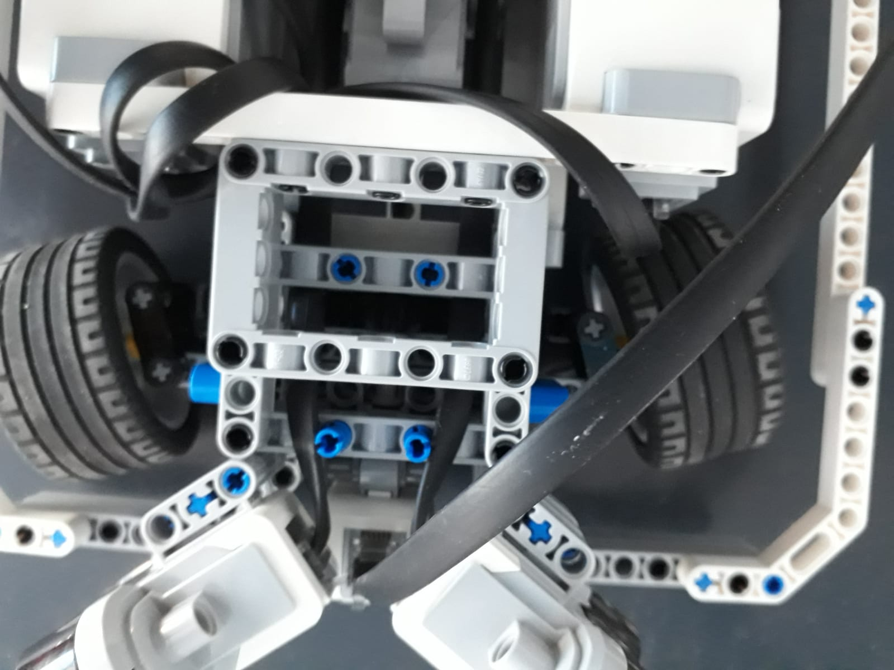
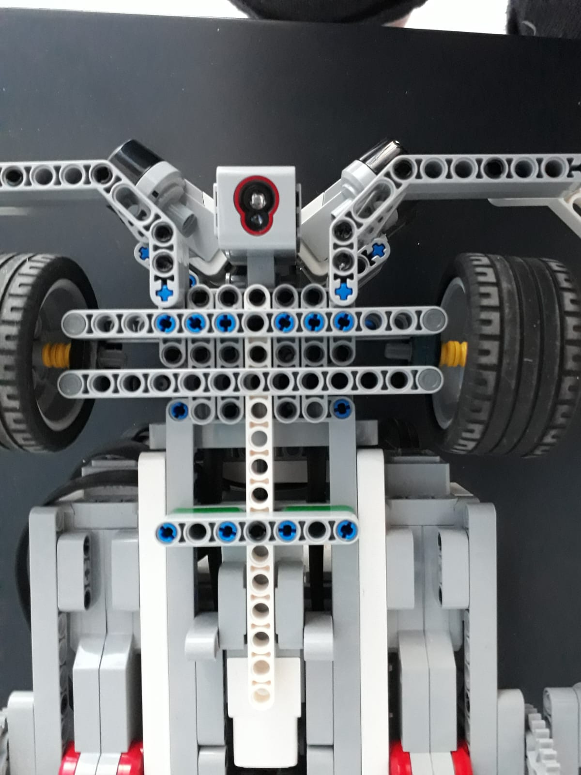
dırectıng
The front wheels can free turn to 2 ways independent. There’s a medium motor for giving a turn ability to car.
Our robot can turn the front wheels over 35 degrees

Slide 5
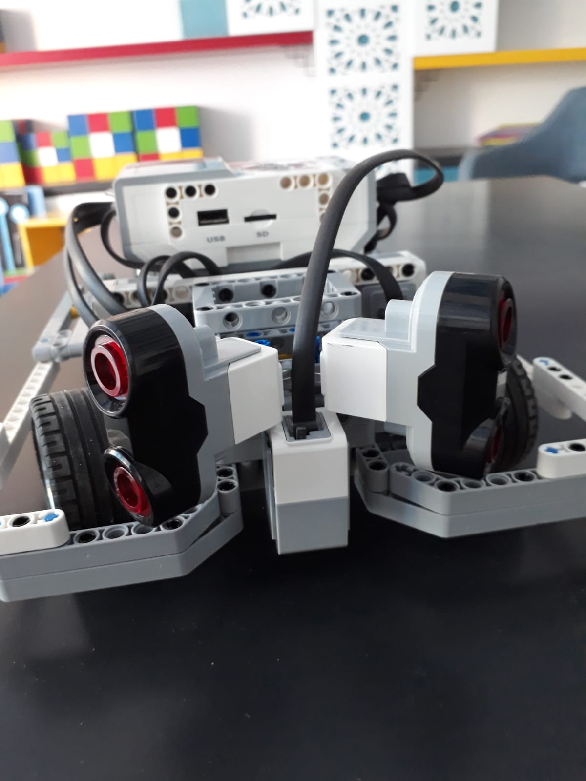
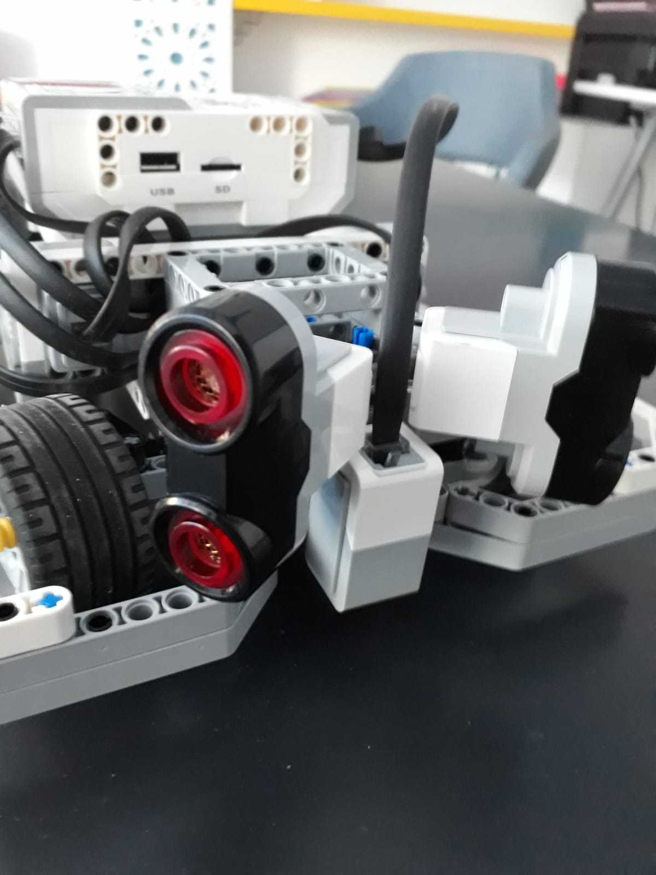
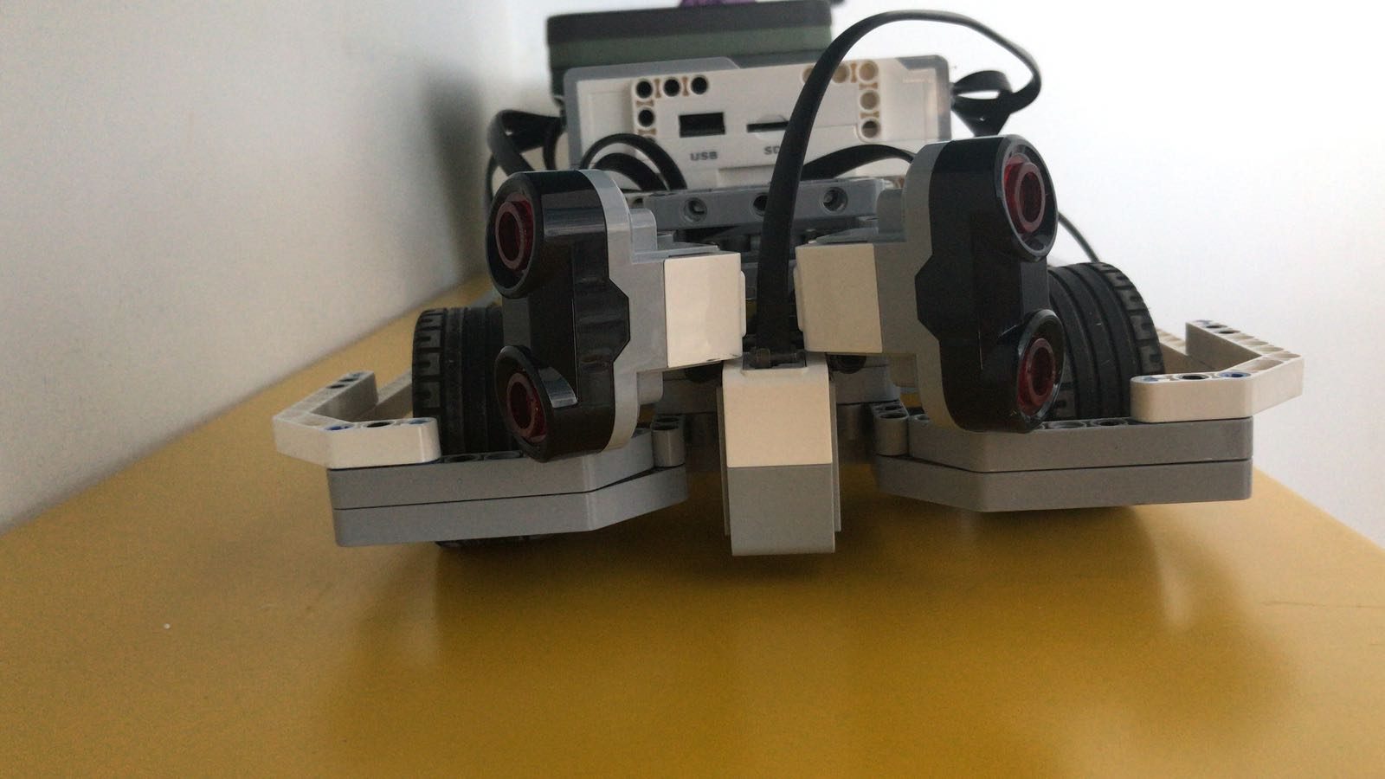
Scannıng
Robot is scanning around with 2 ultasonic sensors and the code is calculating the wich wall is nearest and turning the front wheels to oposite side.

Slide 6
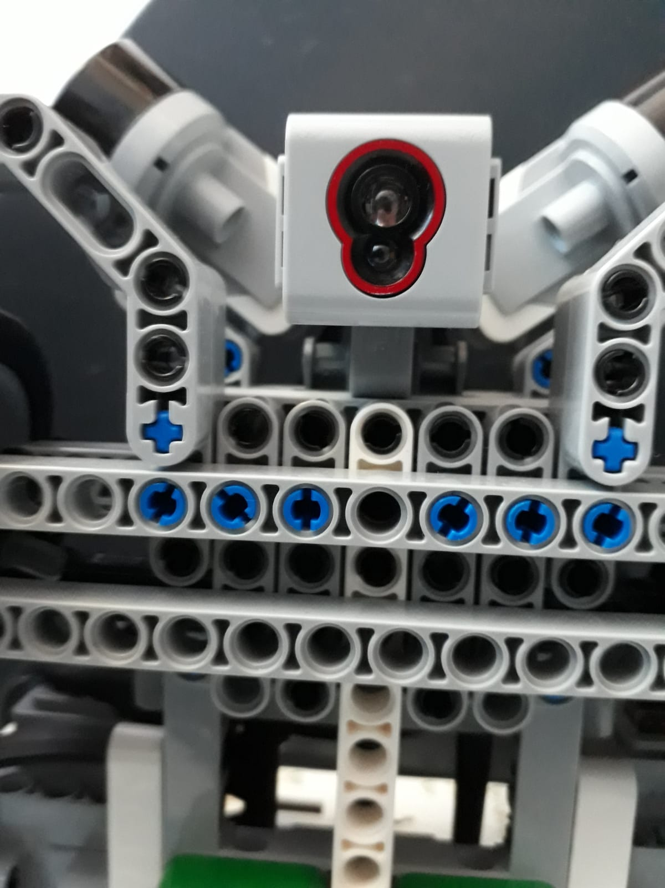
Lıne dedectıng
And our robot also have a color sensor too for seeing the black and white stripes on the ground.

Slide 7
Note,
WE ARE THE ROBUST TEAM AND WE THINK WE COMING FOR GLORY

